Slide 1

Human Computer Interaction Project
Master of Science in Engineering in Computer Science
Accademic year: 2020/2021
Project by:
Gianluca Pulicati 1708686 Loris D’Amico 1678203 Vasile Vladut Gorea 1695720
Professors:
Tiziana Catarci Valeria Mirabella

Slide 2

Idea
«YOUniversity» is an innovative tool designed for University Students.
The application itself is mapped around the students of “M.S. in Engineering in Computer Science”, but this doesn’t exclude the possibility to extend it to every other university course.
YOUniversity is a unique place to collect information: it allows students to make their personal «Study plan» (or learning agreement) by comparing different courses or even discovering new ones. Furthermore, the users are able to actively participate to help the community and their colleagues with their own experiences by leaving reviews and suggestions.
Idea Gathering information Task & Dialogue Analysis Expert Evaluation User Evaluation

Slide 3


What’s the situation without “YOUniversity”?
Confusing, to answer in a single word.
Actually, the possibilities a student has are very limited: whether it is asking to a friend or searching through the university site, it results in a great deal of effort and a time-consuming task, especially during this hard time we are all forced to live.
Thanks to YOUniversity every student can have a clearer view of his possibilities during his course of study, which can be for sure considered as a springboard.
Idea Gathering information Task & Dialogue Analysis Expert Evaluation User Evaluation

Slide 4


Gathering information
Currently, there are no “direct” competitors to our app, the user must search information on his own. The only official way to get information about courses is the searching through the university site, by opening the specific field for every course interested:
The information are reliable since they are written by the professor themselves.
Some professors provide very little information, maybe not up to date
Students may not understand properly what is the main topic of the course
Cannot compare courses in one interface
Cannot see which courses are related to each other
Idea Gathering information Task & Dialogue Analysis Expert Evaluation User Evaluation

Slide 5



User profile
We outlined three type of user for YOUniversity:
#1 First enrolled student:
#3 Graduating student:
Age | 18 – 30 years old
Gender
Location | Everywhere (mainly: Lazio region)
Likes | IT field and technology
Technology | Smartphone and computer expert user
Education | Attending university (bachelor / master)
Study hours | 5-8 per day
Age | 21 – 30 years old
Gender
Location | Everywhere (mainly: Lazio region)
Likes | IT field and technology
Technology | Smartphone and computer expert user
Education | Graduating on bachelor / master degree
Study hours | 5-8 per day
#2 Part-time student:
Age | 18 – 30 years old
Gender
Location | Everywhere (mainly: Lazio region)
Profession | Full time / Part time job
Likes | IT field and technology
Technology | Smartphone and computer expert user
Education | Attending university (bachelor / master)
Study hours | 3-6 per day
Work hours | 4-8 per day
Idea Gathering information Task & Dialogue Analysis Expert Evaluation User Evaluation

Slide 6

Persona #1
Scenario:
Aurora is an only child; she loves her family. Her father passed her the curiosity for computer science and her mother the curiosity for the human psyche. She likes fitness, traveling and sharing feelings and unique moments with friends. After a long day of activities, she likes to relax and hang out with friends.
It’s Sunday, tomorrow lectures are going to start. Aurora, after high school graduation, has spent her summer’s break in the USA. She has visited New York; she has found new friends and she would like to come back there one day. Since she returned too late, she didn’t have the time to gather information and so she is without a good strategy to do that. Luckily, she has many friends that are with her in this course, and she is leaning on them in order to follow an interesting course but she wanted to gather information in first person.
Aurora Ricci, 19 years old
First enrolled student, born in Rome
Idea Gathering information Task & Dialogue Analysis Expert Evaluation User Evaluation

Slide 7

Persona #2
Scenario:
It’s July and Francesca has passed the last exam of her degree. She began to think about the thesis. She would like to do a project on a topic that may be useful for a future job. She talks with some professors to know the possible projects that can do but she is not sure which of them is a good supervisor that guides her during the various phases of the project. She is going to ask for opinions and advice from her colleagues. So, she writes on a “telegram” group and hopes that someone will eventually respond.
Francesca lives in Rome where she shares an apartment with her friend. She is currently attending the last year of Engineering in Computer Science at Sapienza. In her free time, she likes to listen to music and some books.
Francesca de Paolis, 25 years old
Graduating student, born in Frosinone
Idea Gathering information Task & Dialogue Analysis Expert Evaluation User Evaluation

Slide 8
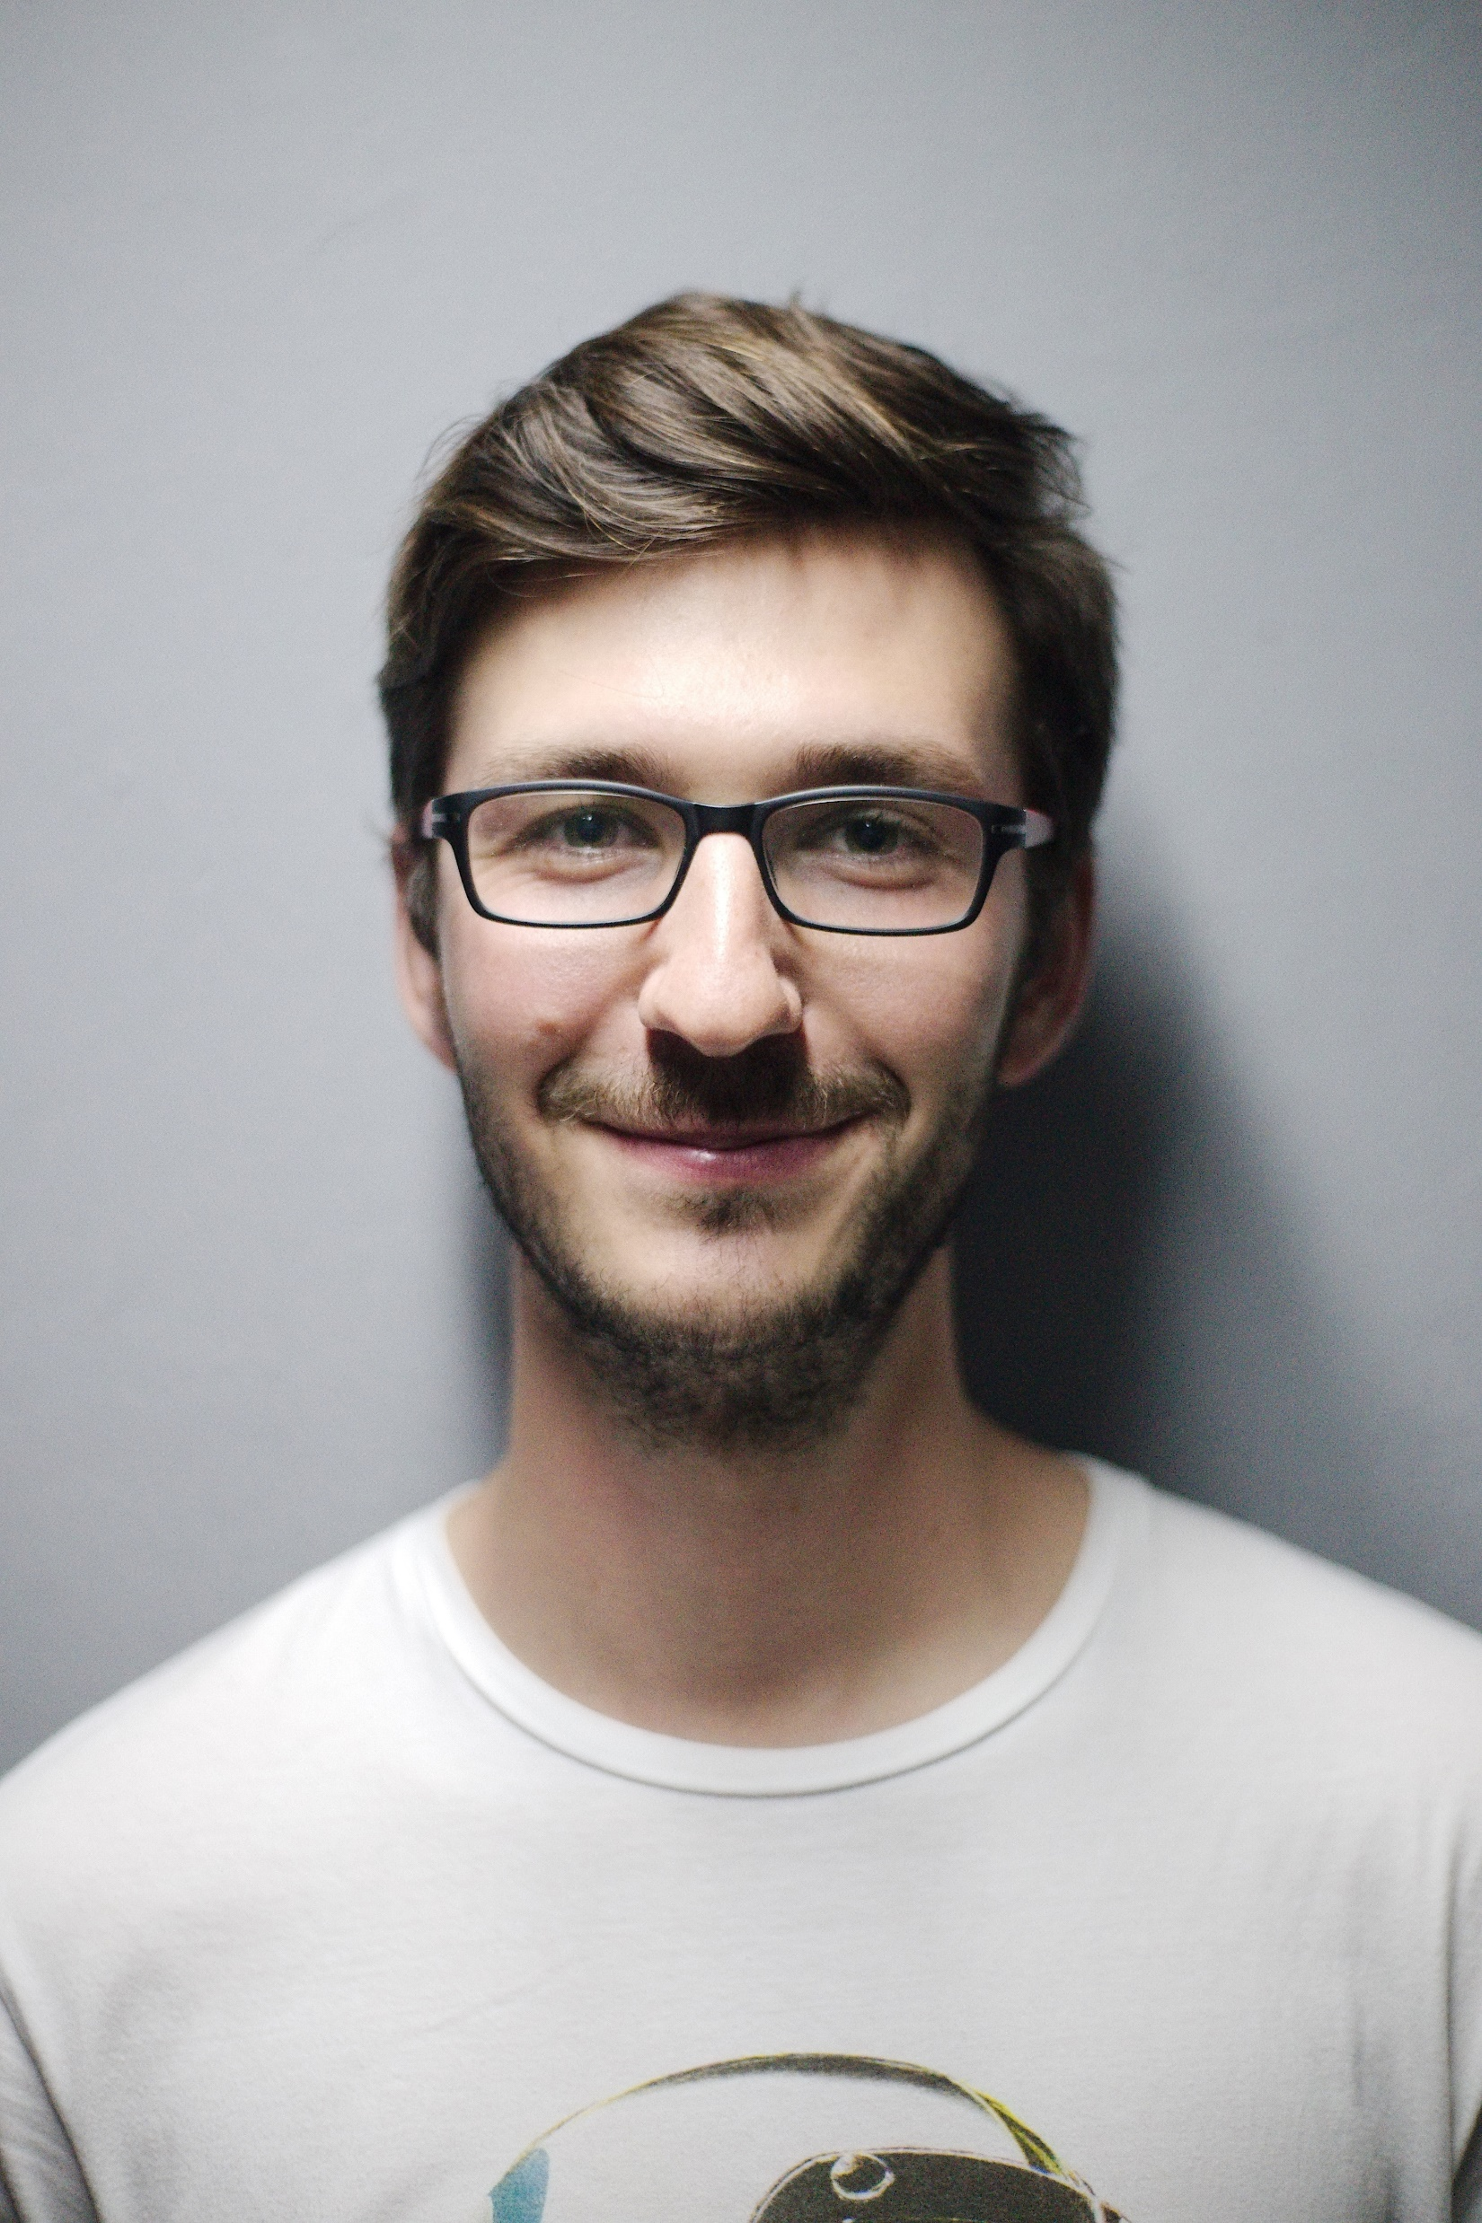
Persona #3
Scenario:
It’s February first, one week since the lectures begin, and Giuseppe has lost the presentation of a course that he was interested in. Due to the pandemic and the new university he has no friends that can pass to him some information. He is so frustrated because he wants to have a good knowledge of the major part of the courses, but his job holds him back. However he is not a compliant type, and therefore he is trying to get in touch with some students through the different social networks. Speaking with one of them he discovered that there is a telegram channel of the master course and here he is finding many people who can answer his questions. Although he prefers to try things on his skin rather than hear them.
Giuseppe is attending the first year of the master in Engineering in computer science. It was so exciting to begin a new experience after his bachelor and a couple of years in a software house. He is married and before having a child, he wants to specialize his knowledge of computer science to reach a good position in his career.
Giuseppe Steppo, 27 years old
Part-time student, born in Rome
Idea Gathering information Task & Dialogue Analysis Expert Evaluation User Evaluation

Slide 9

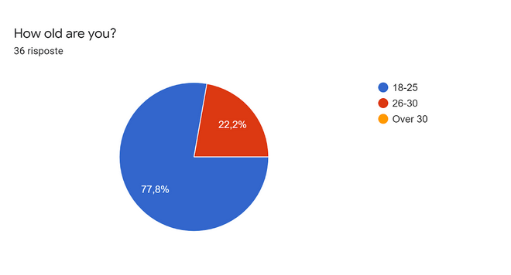
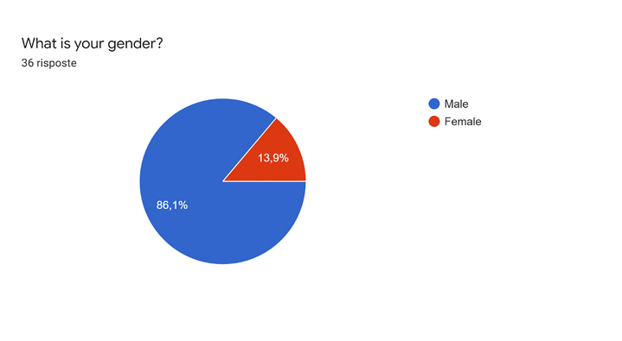
Questionnaire
Before starting the design and the development of the app, we proposed a questionnaire to acquire as much as possible information in order to completely respect the UCD pattern:
Idea Gathering information Task & Dialogue Analysis Expert Evaluation User Evaluation

Slide 10
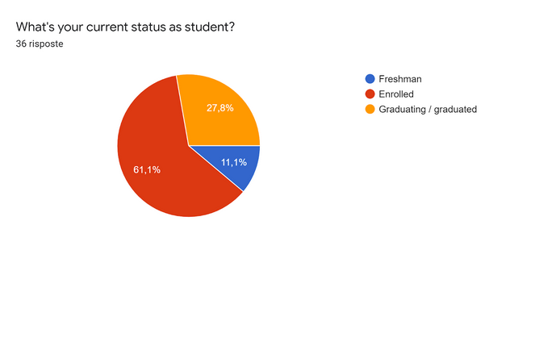
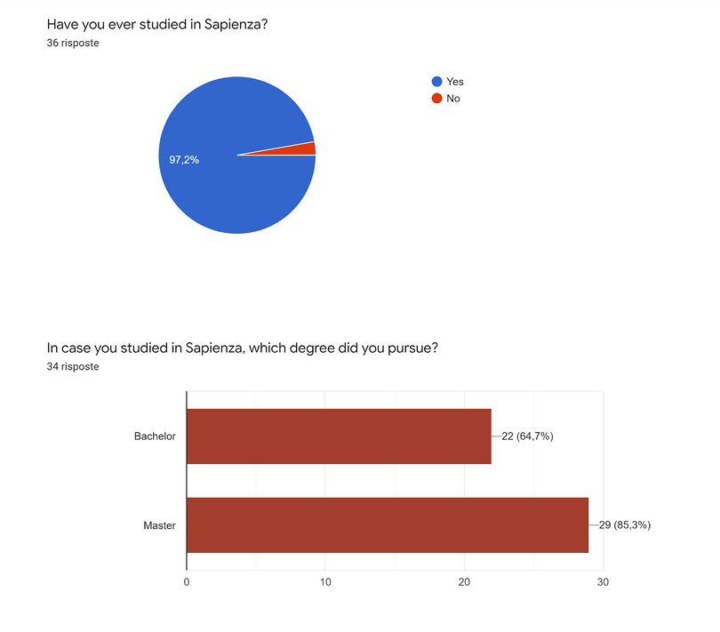
Questionnaire
So, beside having almost the entire interviewers studying in Sapienza, they span from being students who have done the bachelor and stayed for Master to Master’s students who did their bachelor in other universities.
Idea Gathering information Task & Dialogue Analysis Expert Evaluation User Evaluation

Slide 11
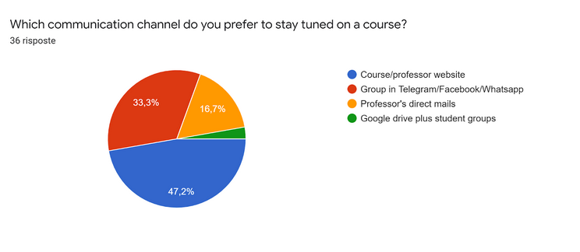
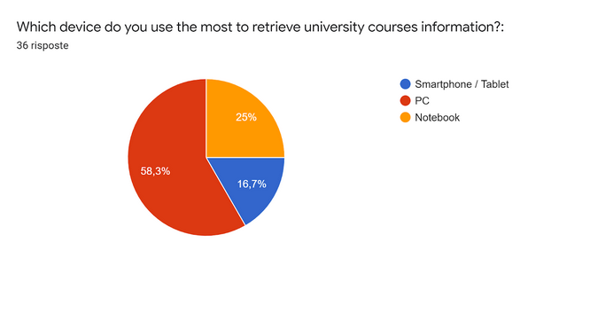
Questionnaire
Idea Gathering information Task & Dialogue Analysis Expert Evaluation User Evaluation

Slide 12
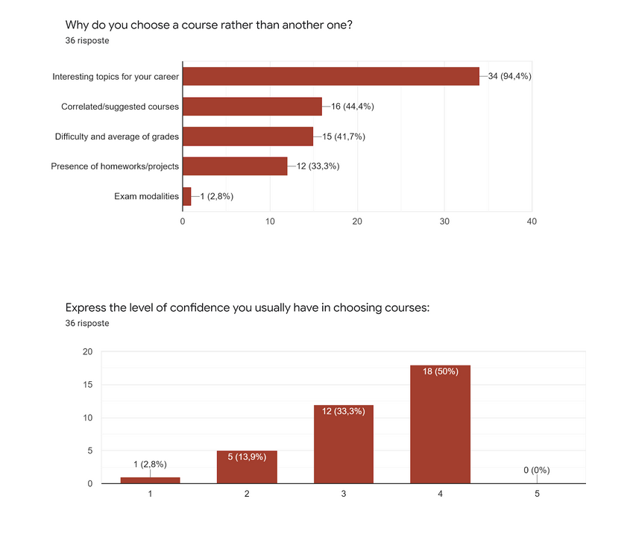
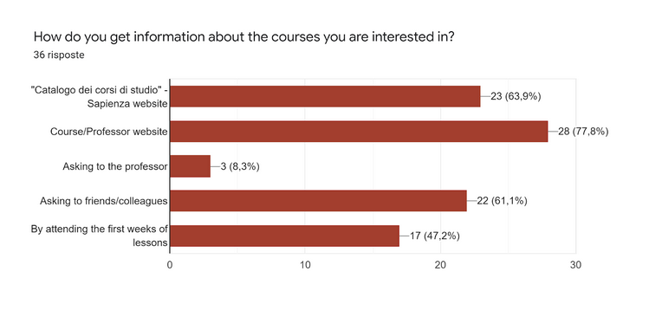
Questionnaire
Idea Gathering information Task & Dialogue Analysis Expert Evaluation User Evaluation

Slide 13
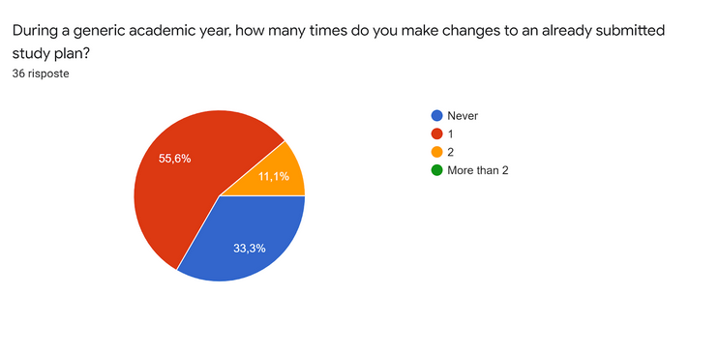
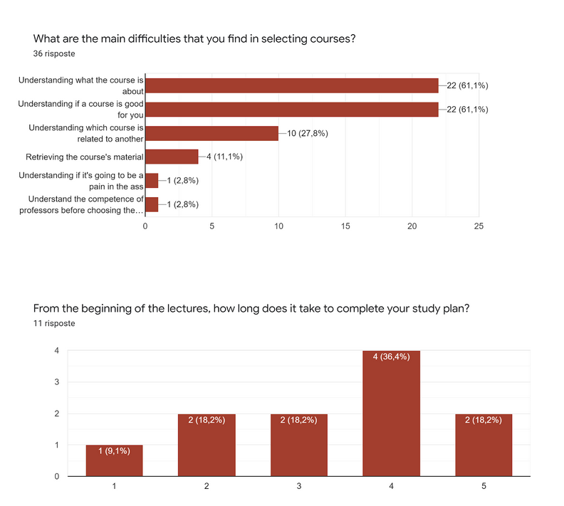
Questionnaire
Probably the most important result so far: from here we can see the confusion the users have even after they submitted the study plan.
To notice that students in Sapienza should not be able to make changes to an already submitted study plan. It is considered definitive once approved.
Idea Gathering information Task & Dialogue Analysis Expert Evaluation User Evaluation

Slide 14
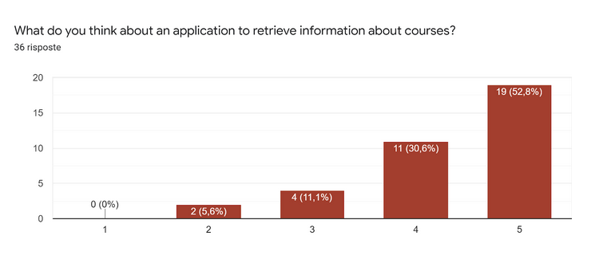
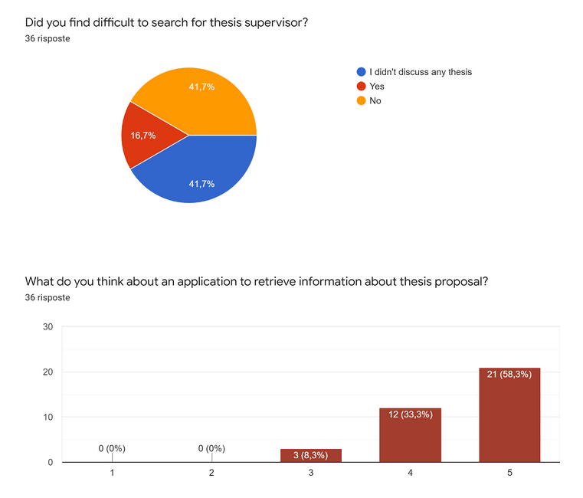
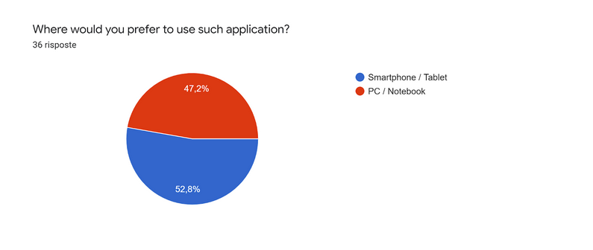
Questionnaire
Idea Gathering information Task & Dialogue Analysis Expert Evaluation User Evaluation

Slide 15
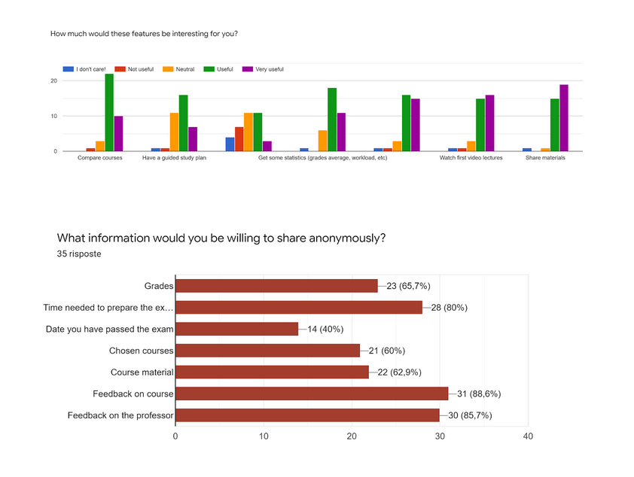
Questionnaire
Conclusions:
To conclude, thanks to the Questionnaire we understood some other crucial points:
Most of the them are enrolled and only some of them also work;
Most of the them use pc to to retrieve university courses information but most of them would like an app to do it;
They are interested in comparing courses, having a guided study plan, a dashboard with their career situation and being able to get some statistics and opinions of colleagues;
On the contrary, they are not interested in taking a look at their colleagues' study plan, so we discarded this service.
Idea Gathering information Task & Dialogue Analysis Expert Evaluation User Evaluation

Slide 16
Task: Accomplish a study plan
HTA
0. Accomplish a study plan
Plan 0
Do in order 1,2,3
Collect information
2. Analyse information
3. Choose courses
Idea Gathering information Task & Dialogue Analysis Expert Evaluation User Evaluation

Slide 17
Task: Accomplish a study plan
HTA
1. Collect information:
Plan 1 Do 1.1, 1.2, then in any order if necessary 1.3.,1.4.,1.5
1.1. Take information from the university’s website
1.2. Get info on course
1.3. Ask to professor deeper information
1.4. Ask around
1.5. Attend some lessons
Plan 1.1
Do in order 1.1.1, 1.1.2
Plan 1.3
do in any order 1.3.1, 1.3.2
Plan 1.5
do in any order
1.1.1. Select your degree
1.1.2. Go on the attendance page
1.3.1. Send an email
1.3.2. Go at the student’s hour
Plan 1.2 Do {1.2.1,1.2.2, 1.2.3} while(not satisfied);
1.5.1. Wait for the start of lectures
1.5.2. Watch the recording of the previous years.
Plan 1.4
do in any order 1.4.1, 1.4.2
1.2.1. Get the link to the professor website
1.2.2. Look for additional information on the website
1.2.3. Look at the course materials
1.4.1.Talk with friends/colleagues
1.4.2. Ask for opinion in social groups
Idea Gathering information Task & Dialogue Analysis Expert Evaluation User Evaluation

Slide 18
Task: Accomplish a study plan
HTA
2. Analyse information:
Plan 2. Do in any order 2.1, 2.2, 2.3
2.1. Evaluate difficulty
2.2. Consider modality of exam
2.3. Consider useful/related exam
Plan 2.1 Do in any order 2.1.1, 2.1.2,
2.1.1. Consider topic
2.1.2. Look for the materials
2.1.3. Consider average grades
Idea Gathering information Task & Dialogue Analysis Expert Evaluation User Evaluation

Slide 19
Task: Accomplish a study plan
HTA
3. Choose courses
Plan 3.
Do in order 3.1, 3.2, 3.3
3.1. Make a list of interesting courses
3.2. Review course list preferences
3.3. Select the courses to add to the study plan
Plan 3.2
Do {3.2.1, 3.2.2, 3.2.3} While (not satisfied)
3.2.1. Compare characteristics of courses
3.2.2. Sort them according to your preference
3.2.3. Order them evaluating the time constraints
Idea Gathering information Task & Dialogue Analysis Expert Evaluation User Evaluation

Slide 20
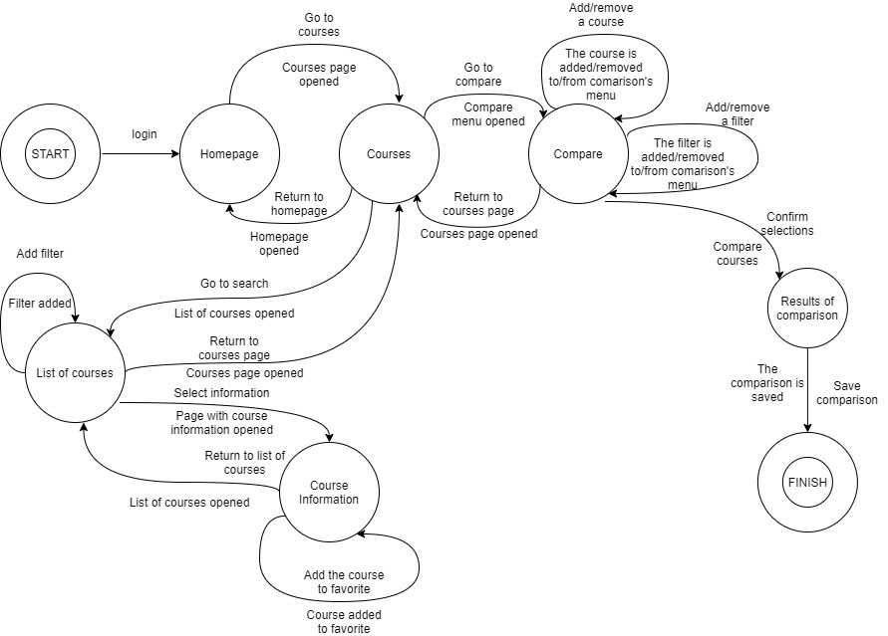
Task: Accomplish a study plan
STN
Idea Gathering information Task & Dialogue Analysis Expert Evaluation User Evaluation

Slide 21
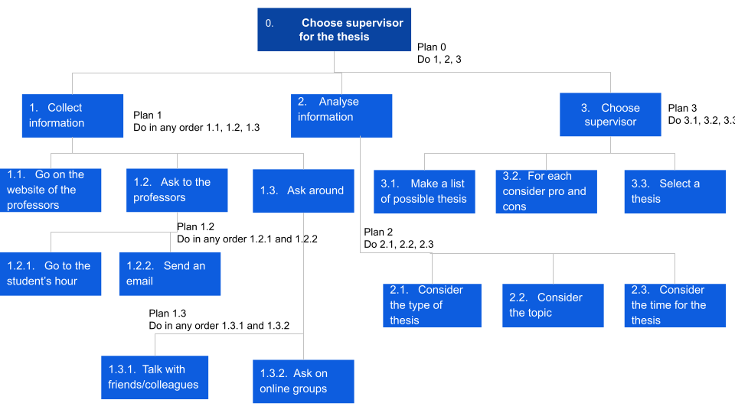
Task: Choose supervisor for the thesis
HTA
Idea Gathering information Task & Dialogue Analysis Expert Evaluation User Evaluation

Slide 22
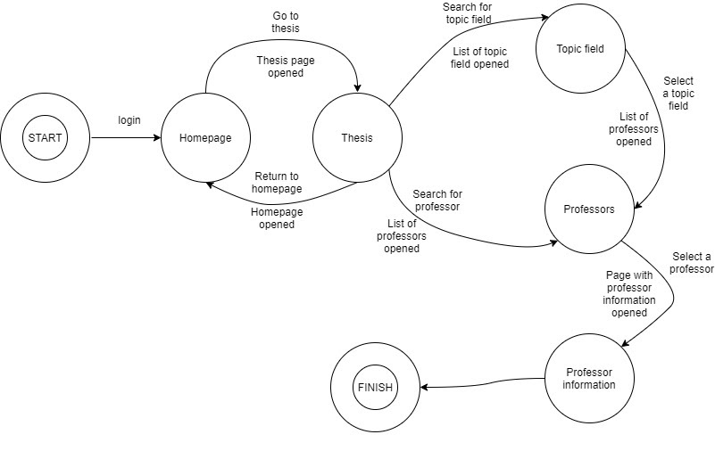
Task: Choose supervisor for the thesis
STN
Idea Gathering information Task & Dialogue Analysis Expert Evaluation User Evaluation

Slide 23
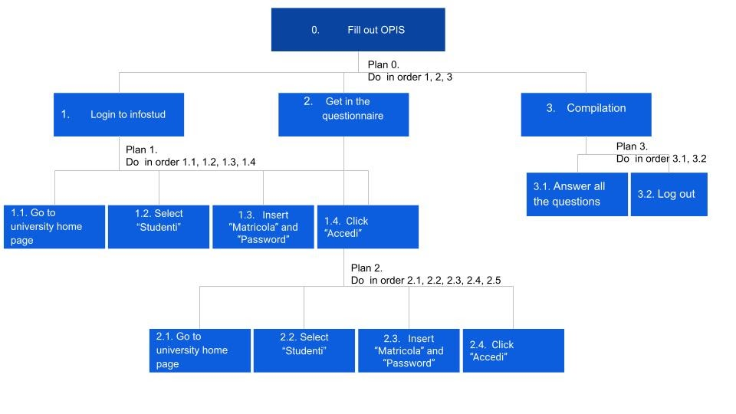
Task: Fill out OPIS
HTA
Idea Gathering information Task & Dialogue Analysis Expert Evaluation User Evaluation

Slide 24
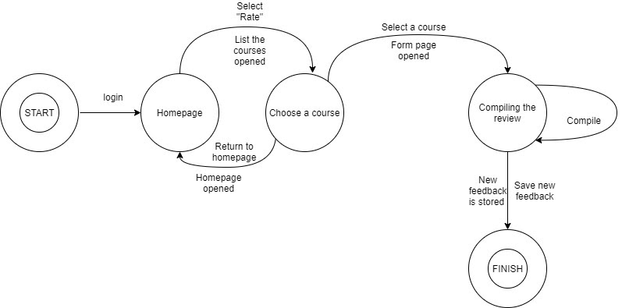
Task: Fill out OPIS
STN
Idea Gathering information Task & Dialogue Analysis Expert Evaluation User Evaluation

Slide 25
Heuristic Evaluation
Frame | Heuristic violated | Severity | Description / Comment
Compare courses | Aesthetic and minimalist design | 3 | The page is full of information that could be not relevant for the specific comparison and rarely needed
Compare courses | Recognition rather than recall | 3 | Minimize the user's memory load in comparison guiding the task (for example with a wizard).
All (see for example Exam in Profile) | Visibility of system status | 2 | Consider adding some additional information like breadcrumbs
All | Flexibility and efficiency of use | 3 | In order to speed up the interaction consider the possibility to save comparisons.
The "severity" number identifies:
0 = I don’t agree that this is a usability
problem at all;
1 = Cosmetic problem only;
2 = Minor usability problem;
3 = Major usability problem;
4 = Usability catastrophe.
Idea Gathering information Task & Dialogue Analysis Expert Evaluation User Evaluation

Slide 26
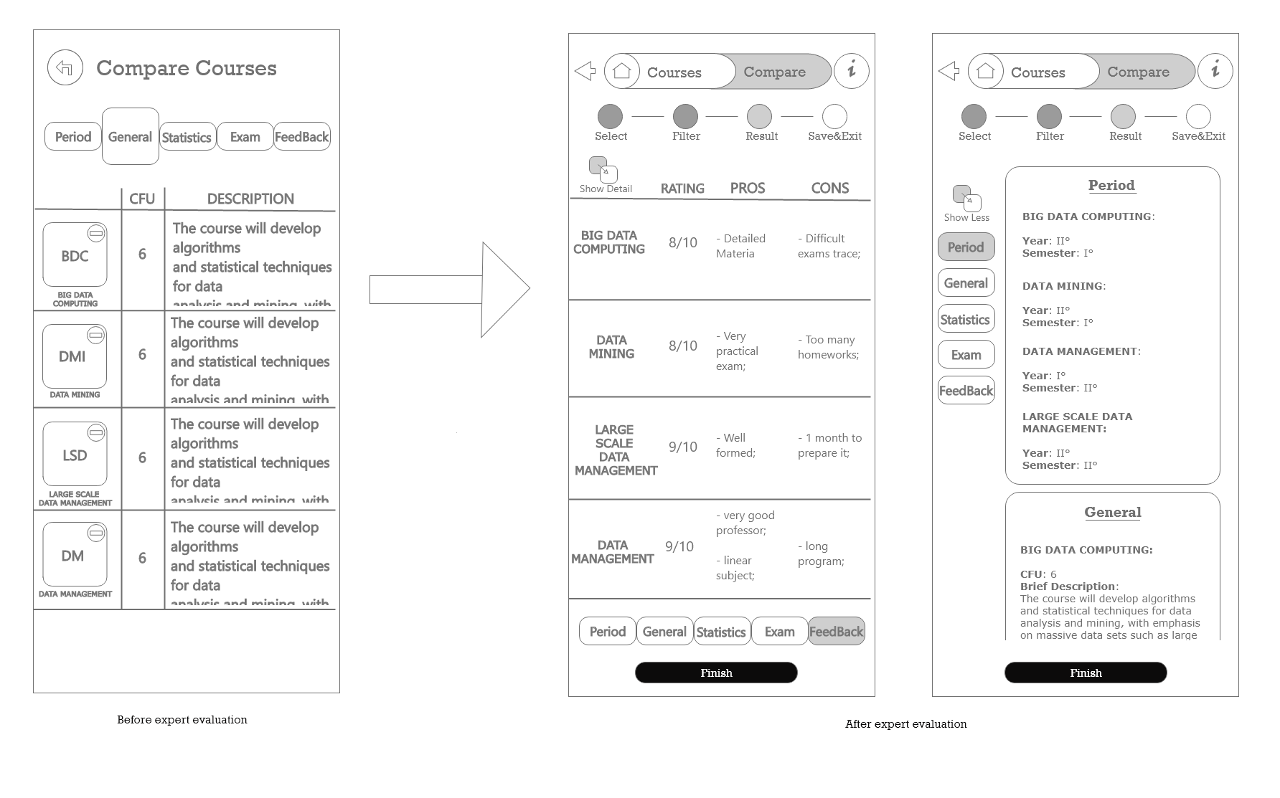
Solution to Heuristics violated
Idea Gathering information Task & Dialogue Analysis Expert Evaluation User Evaluation

Slide 27
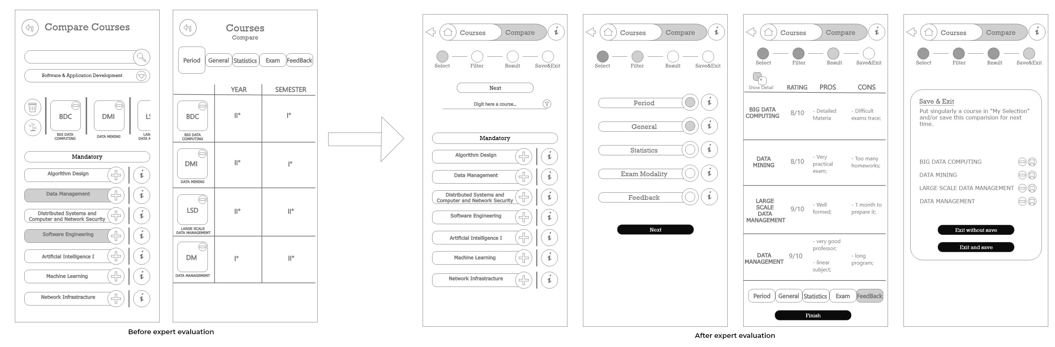
Solution to Heuristics violated
Idea Gathering information Task & Dialogue Analysis Expert Evaluation User Evaluation

Slide 28
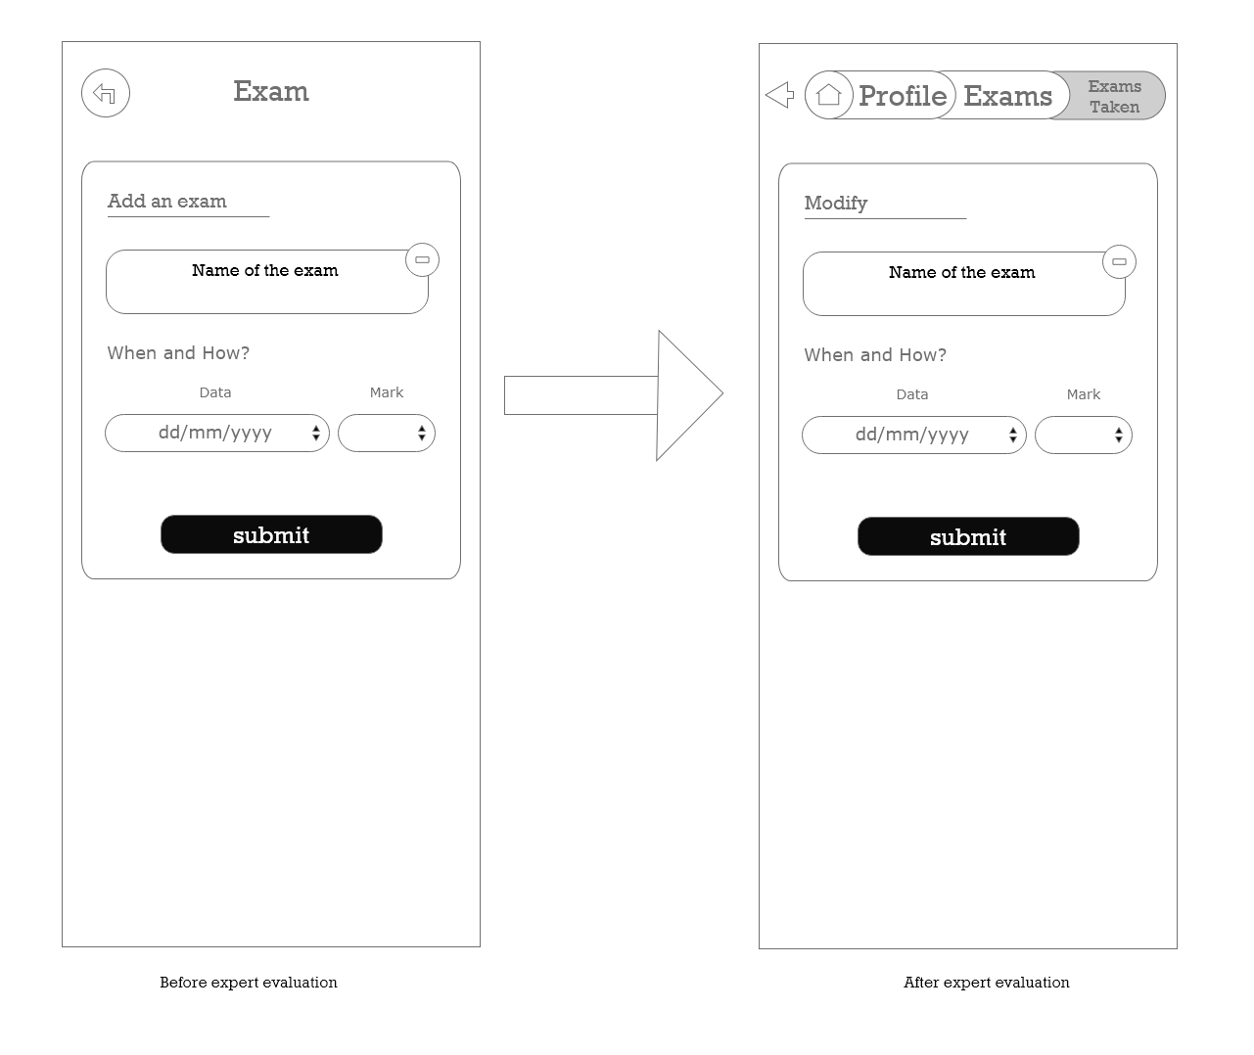
Solution to Heuristics violated
Idea Gathering information Task & Dialogue Analysis Expert Evaluation User Evaluation

Slide 29
Cognitive Walkthrough
In this case the evaluation was done on two tasks:
Compare Courses;
Modify a review.
For each action in our list the expert answered the following questions:
Is the effect of the action the same as the user’s goal at that point?
Will users see that the action is available?
Once users have found the correct action, will they know it is the one they need?
After the action is taken, will users understand the feedback they get?
Idea Gathering information Task & Dialogue Analysis Expert Evaluation User Evaluation

Slide 30
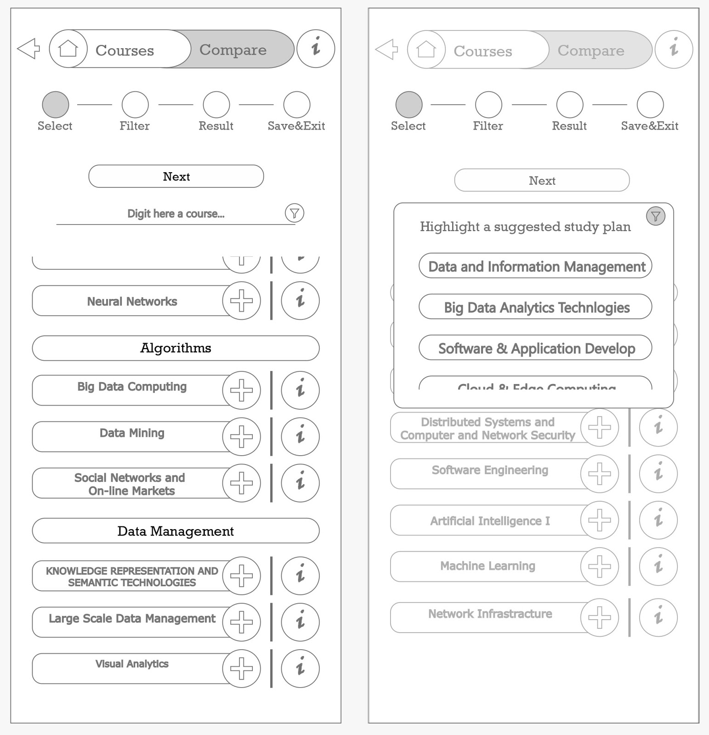
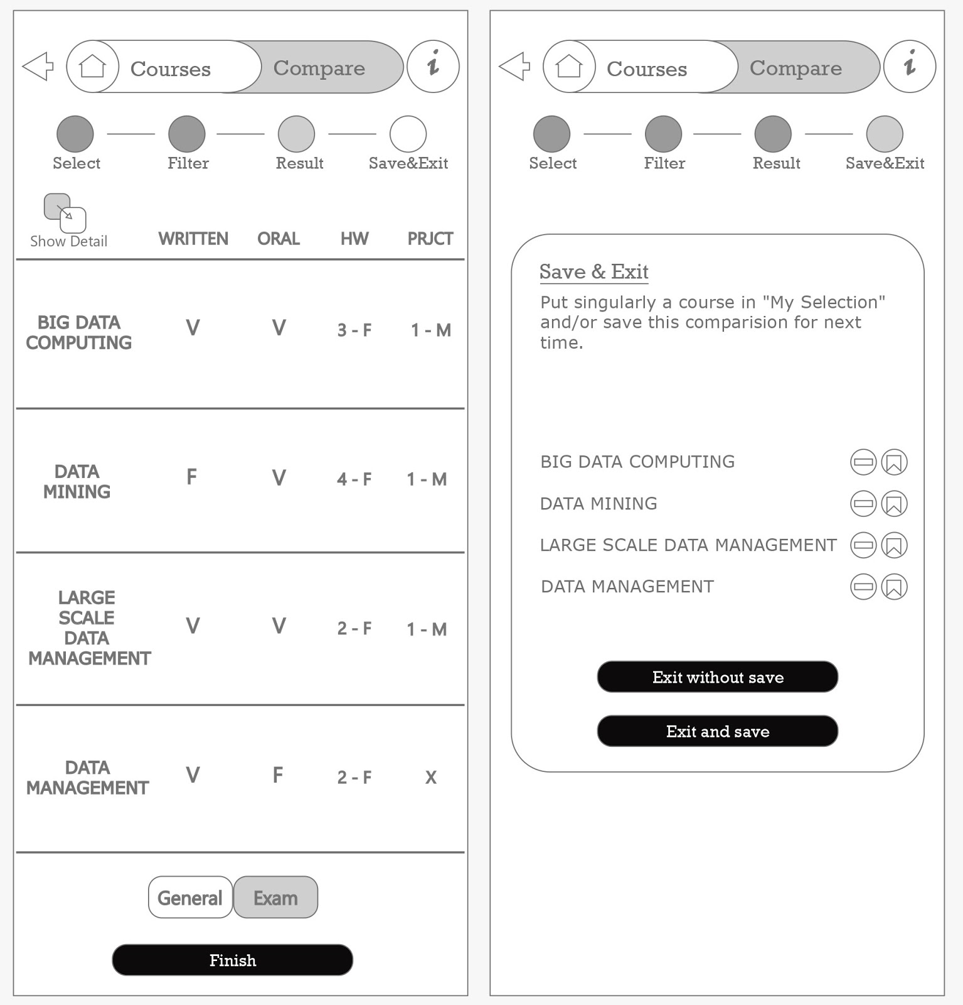
Cognitive Walkthrough
Act 3: Press the button icon of filtering.
Resp 3: a scroll menu is opened on the same page.
Q3: The icon is clear but not evident. It is reasonable that the user could have some difficulties.
Solution for q3: we decided to make the icon of filtering bigger.
Act 9: Press the button to continue.
Resp 9: The system moves to the last wizard point “Save & Exit”, it shows the list of courses with a delete and prefer icon, then two buttons to express the last action.
Q3: There is no button or similar labelled as “Continue”. The user will use the “Finish” button.
Solution for q3: we decided to add the “Continue” button.
Idea Gathering information Task & Dialogue Analysis Expert Evaluation User Evaluation

Slide 31
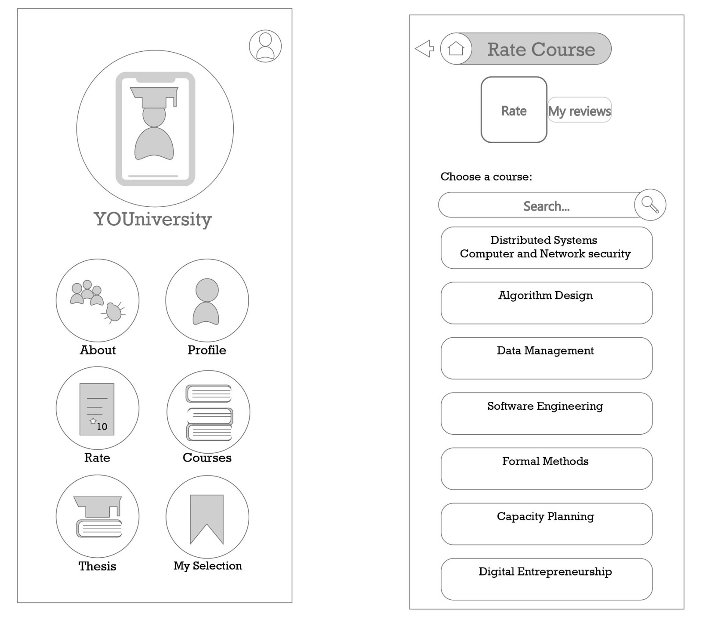
Cognitive Walkthrough
Act. 1: Press the button to rate a course.
Resp. 1: The page “Rate course" is opened, showing two possibilities: “Rate” and “My reviews”.
Q3: The user could be in doubt if access the Course or the Rate section
Solution for q3: we decided to rename the page “Rate course” with “Rate” and the text “Choose a course” with “Choose a course to rate”.
Idea Gathering information Task & Dialogue Analysis Expert Evaluation User Evaluation

Slide 32
User Evaluation
The aim of this step is to test the learnability and the usability of the application.
We perform the test with a working prototype implemented in Axure.
Participant:
Ideal final users: students.
Group of 10 people, average age between 23-27.
Fresh enrolled students, part-time worker and middle of career.
Ambient:
Experiments video-calling (laboratory environment)
Artificial distractions.
Test executed:
Think Aloud + Post Walkthrough.
Cooperative Evaluation.
Controlled Experiment.
Idea Gathering information Task & Dialogue Analysis Expert Evaluation User Evaluation

Slide 33
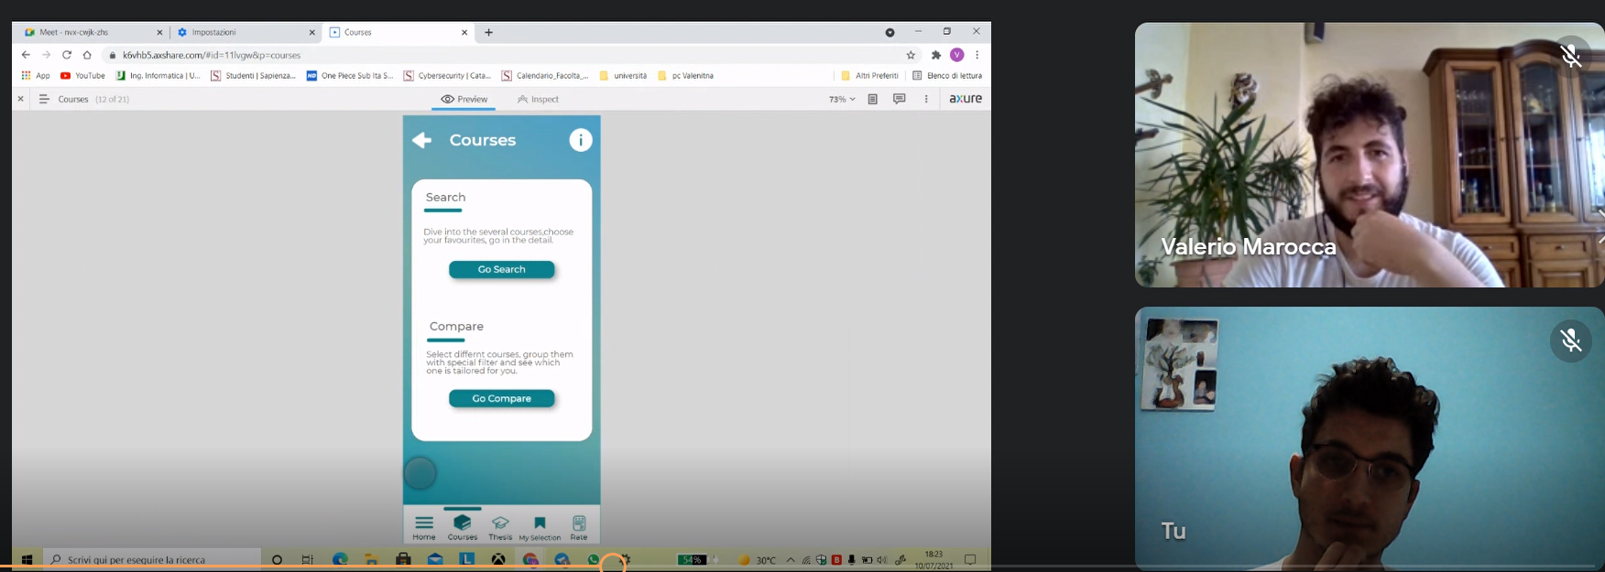
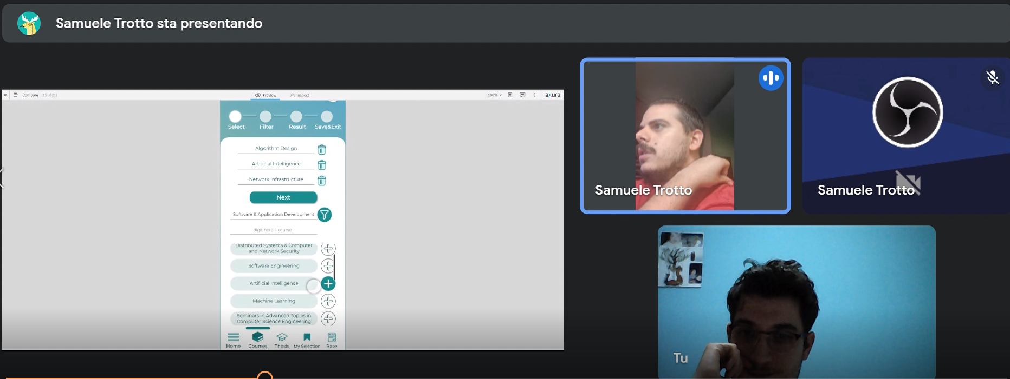
User Evaluation Think Aloud + Post Walkthrough
In order to check the heuristics, usability and learnability.
We asked for executing the following 3 main tasks:
Compare courses.
Rate a course.
Search for thesis supervisor.
Post Walkthrough: Questions inherent to the specific behaviour and choices taken by the single user:
“Why did you click on this thing?”
“What were you looking at?”
“What did you expect clicking on that?”
Idea Gathering information Task & Dialogue Analysis Expert Evaluation User Evaluation

Slide 34
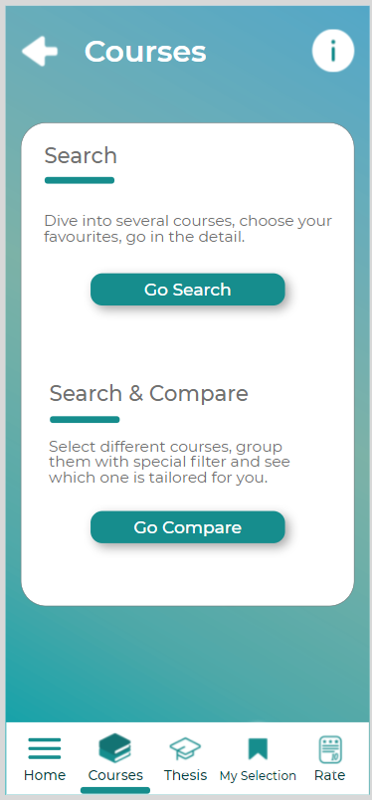
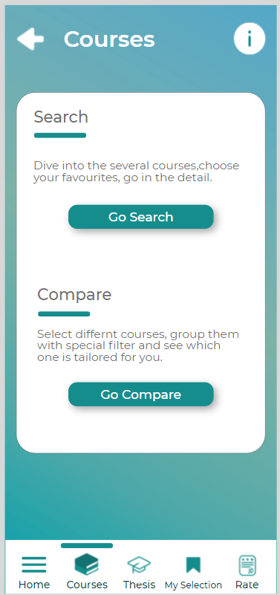
User Evaluation Think Aloud Results
Graphical details that did not work well and seemed to be confusing for the user. The most impressive result:
Search and Compare: Confusing the two tasks.
Search and Compare: Confusing the two tasks: “In order to compare you need first of all to search for courses”.
Solution: edited and improved the description of the two tasks in “Search” and “Search & Compare”.
Idea Gathering information Task & Dialogue Analysis Expert Evaluation User Evaluation
34

Slide 35
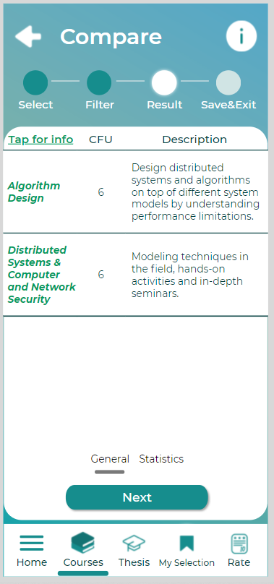
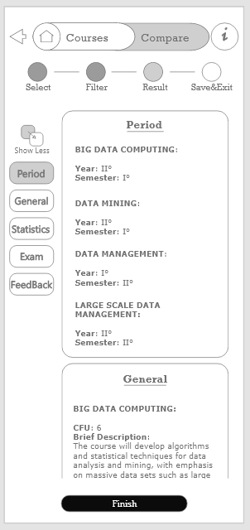
User Evaluation Cooperative Evaluation
In order to gather suggestions and understand how the user feels the experience while navigating the application and how they would improve it.
Compare courses: Is the double option viewing the data really needed?
To the users we asked: a. Given that you can simply tap on a course name and get all the details of it, would you use this “More detail” section? How often?
b. If this section was not present, would you miss it?
Results: the whole team answered, “It is a good feature, but I would rarely use it.”.
Idea Gathering information Task & Dialogue Analysis Expert Evaluation User Evaluation

Slide 36
User Evaluation Controlled Experiment
By this experiment we wanted to check several things, the most interesting was:
First impact usability VS slide show information: if the user commits less errors if he sees a brief help slide show.
We have assigned a complex job to the user: “Compare 3 courses belonging to the software application and development study plan and then save the comparison deleting one of them”
In the case of the help interface we obliged the user to read the info slides and then perform the action.
Idea Gathering information Task & Dialogue Analysis Expert Evaluation User Evaluation

Slide 37
User Evaluation Controlled Experiment
The methods used are: Within groups and within subjects: the transfer of learning phenomenon is present. Therefore, we divided the two groups in 1 and 2, then we showed them alternative A and B.
Dependent variables:
Under consideration the following dependent variables: errors, speed:
Errors: “number of useless tap”.
Speed: “time to reach the goal”.
Formulation of our hypothesis in terms of independent variables:
First impact usability VS slide show information: The user commits less errors if he sees a brief help slide show.
Idea Gathering information Task & Dialogue Analysis Expert Evaluation User Evaluation

Slide 38
User Evaluation ANOVA F - test
Recalling: ANOVA helps you to understand how groups are different. If there is a statistically significant result, then it means that the two populations are unequal (or different).
We performed the ANOVA test using Excel.
Idea Gathering information Task & Dialogue Analysis Expert Evaluation User Evaluation

Slide 39
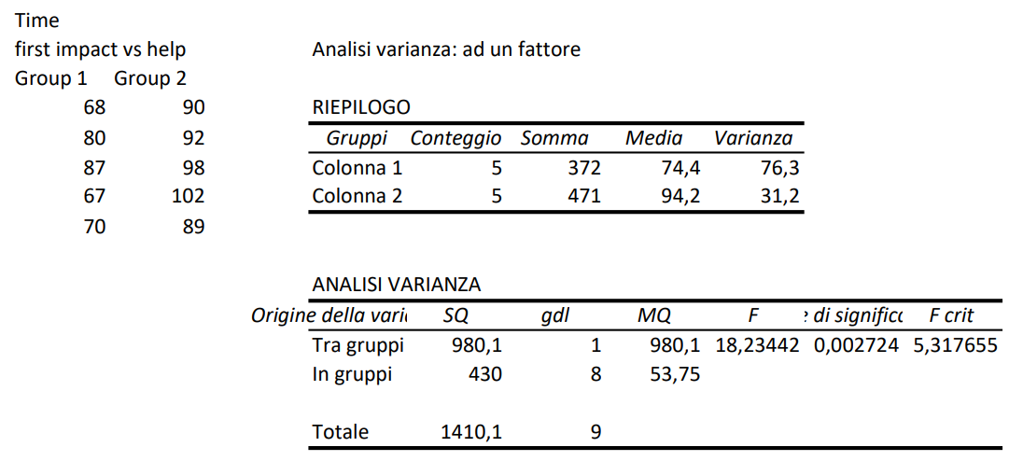
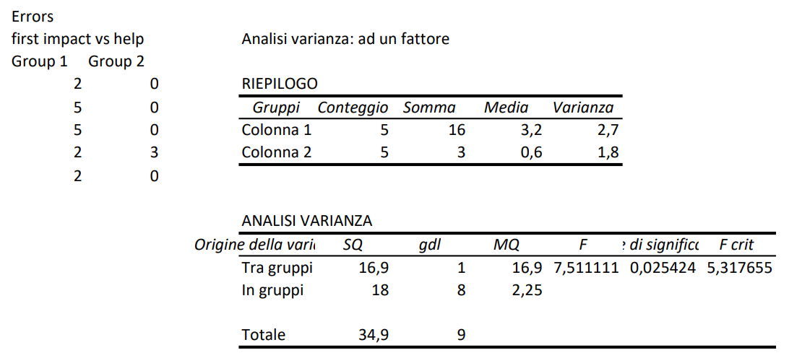
User Evaluation ANOVA F - test
Time evaluation: F > F-crit, therefore we can state that the null hypothesis saying the two methods of interactions are equal is rejected. We can see how reading the help took a long time for the user.
Accuracy evaluation: F > F- crit and so we can neglect the null hypothesis. We can state that the help slides in major part of the user was a good helper
Conclusion: We have implemented the help in an info button, but we did not require the user to see it at his first look on the application.
Idea Gathering information Task & Dialogue Analysis Expert Evaluation User Evaluation

Slide 40
Thanks for your attention.

